Slide 1


Predicting daily stock market movement with machine learning (and other strategies)
Brian Gordon
Regis University
MSDS 696 – Practicum II

Slide 2
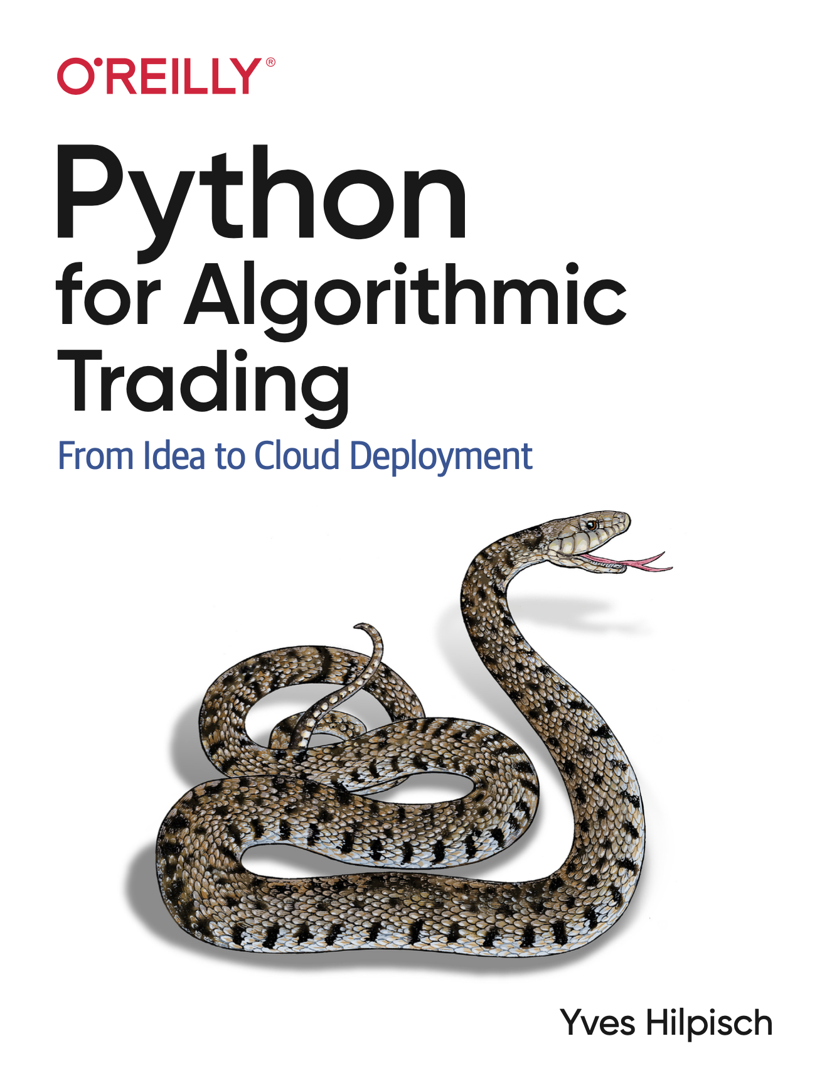
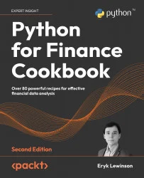
References
by Yves Hilpisch
ISBN: 9781492053354
by Eryk Lewinson
ISBN: 9781803243191

Slide 3
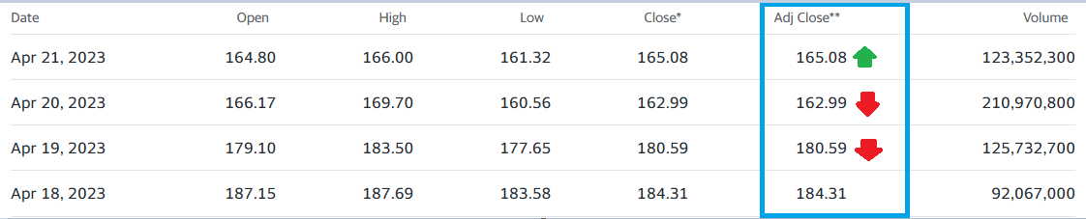
Purpose
Goal is to predict a stock’s daily movement direction. The purpose of this prediction is to make investment decisions that turn a profit

Slide 4


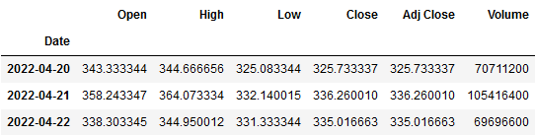
Data
Obtain historical stock data (prices, volume, etc.)
API
yfinance

Slide 5
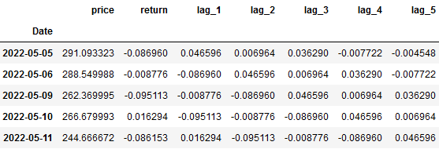
Data Preparation
Calculate indicators & lags

Slide 6
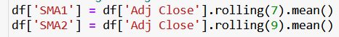
Data Preparation
Rolling average
Volatility

Slide 7
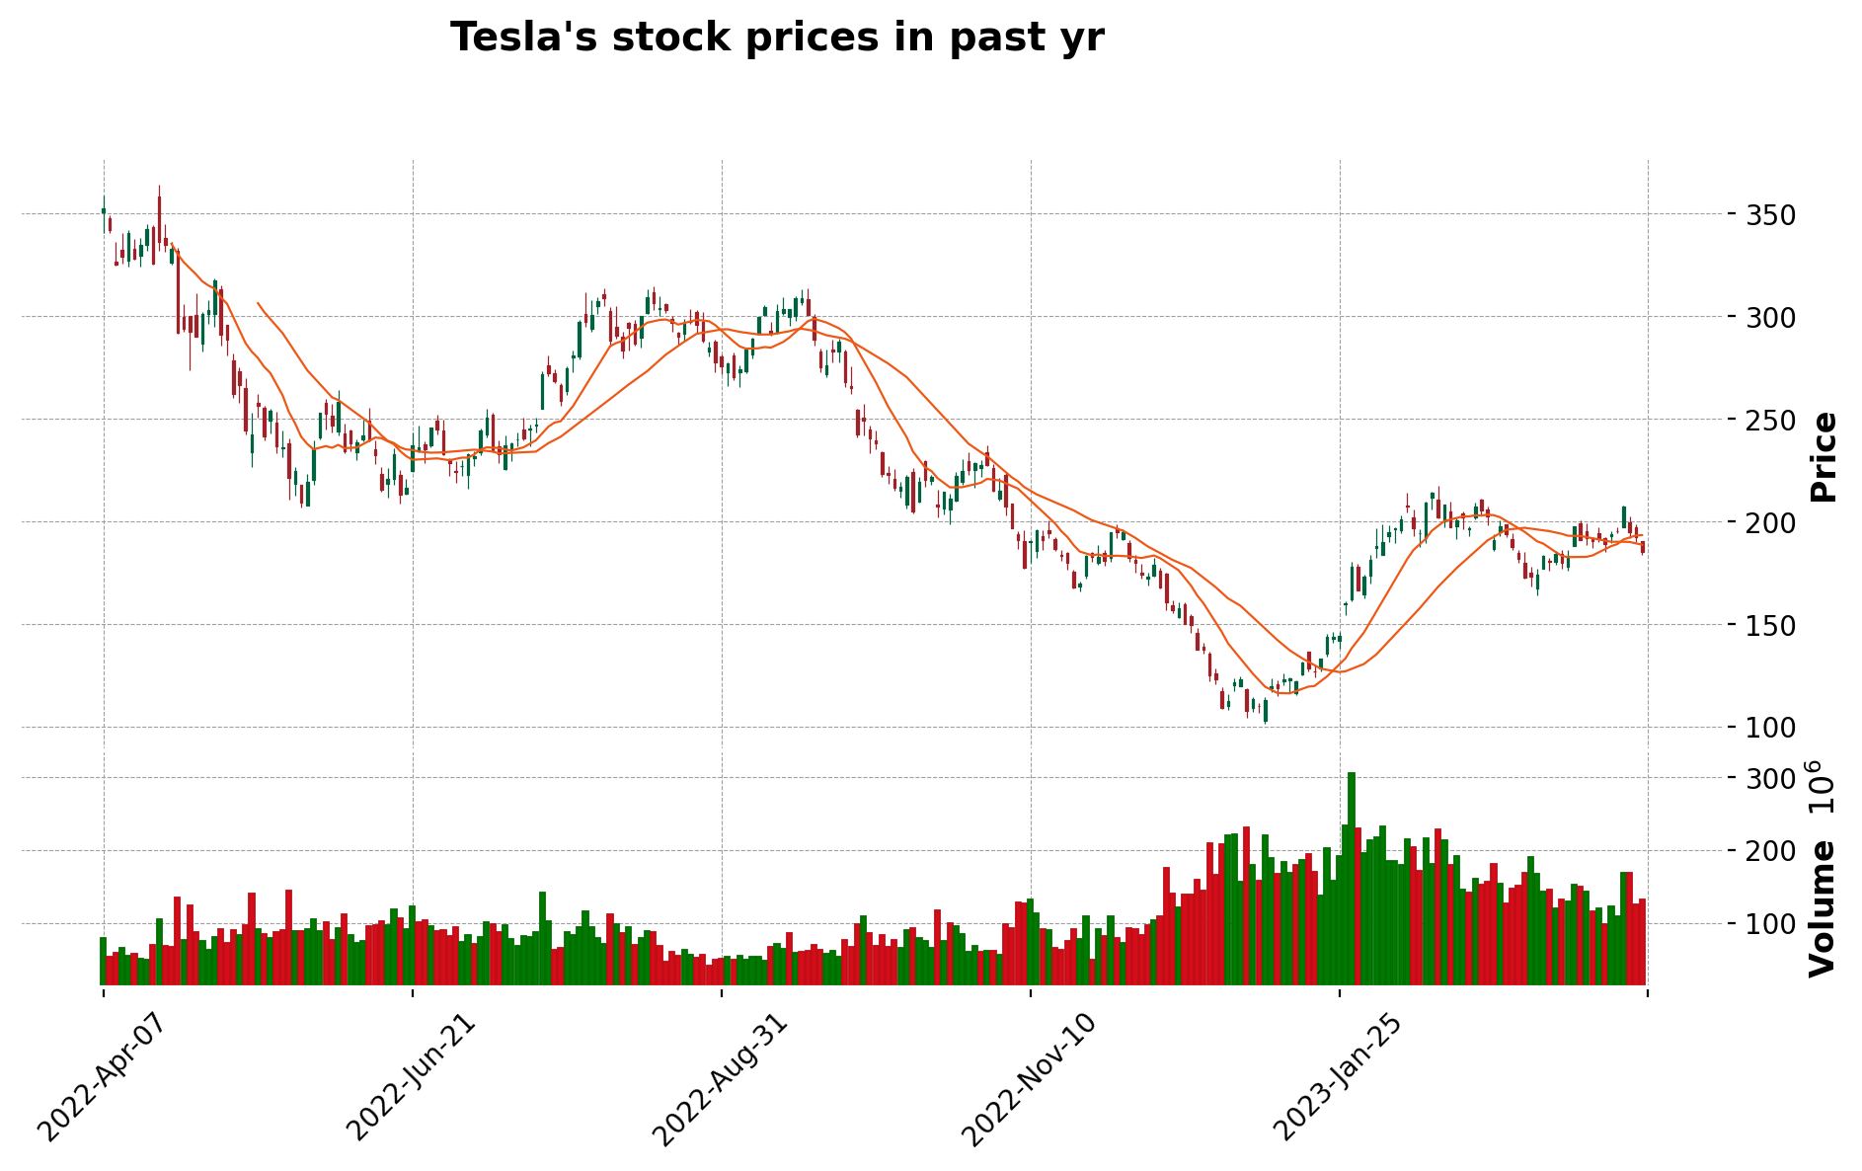
EDA & Visualization

Slide 8
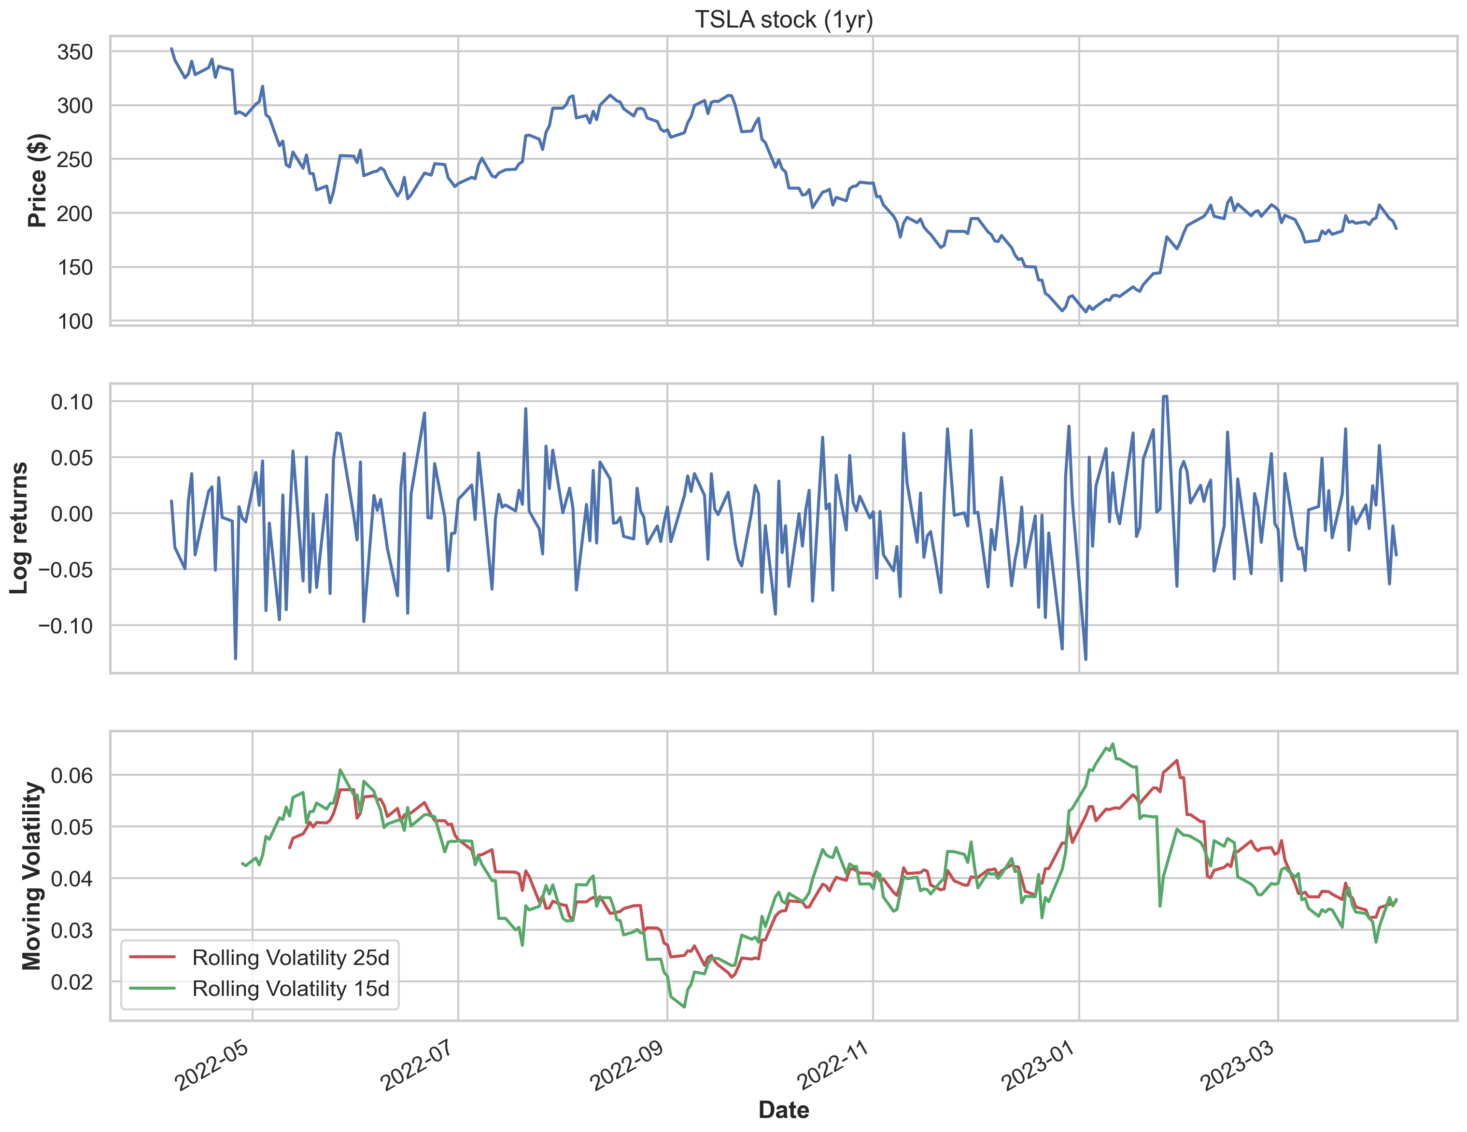
EDA & Visualization

Slide 9
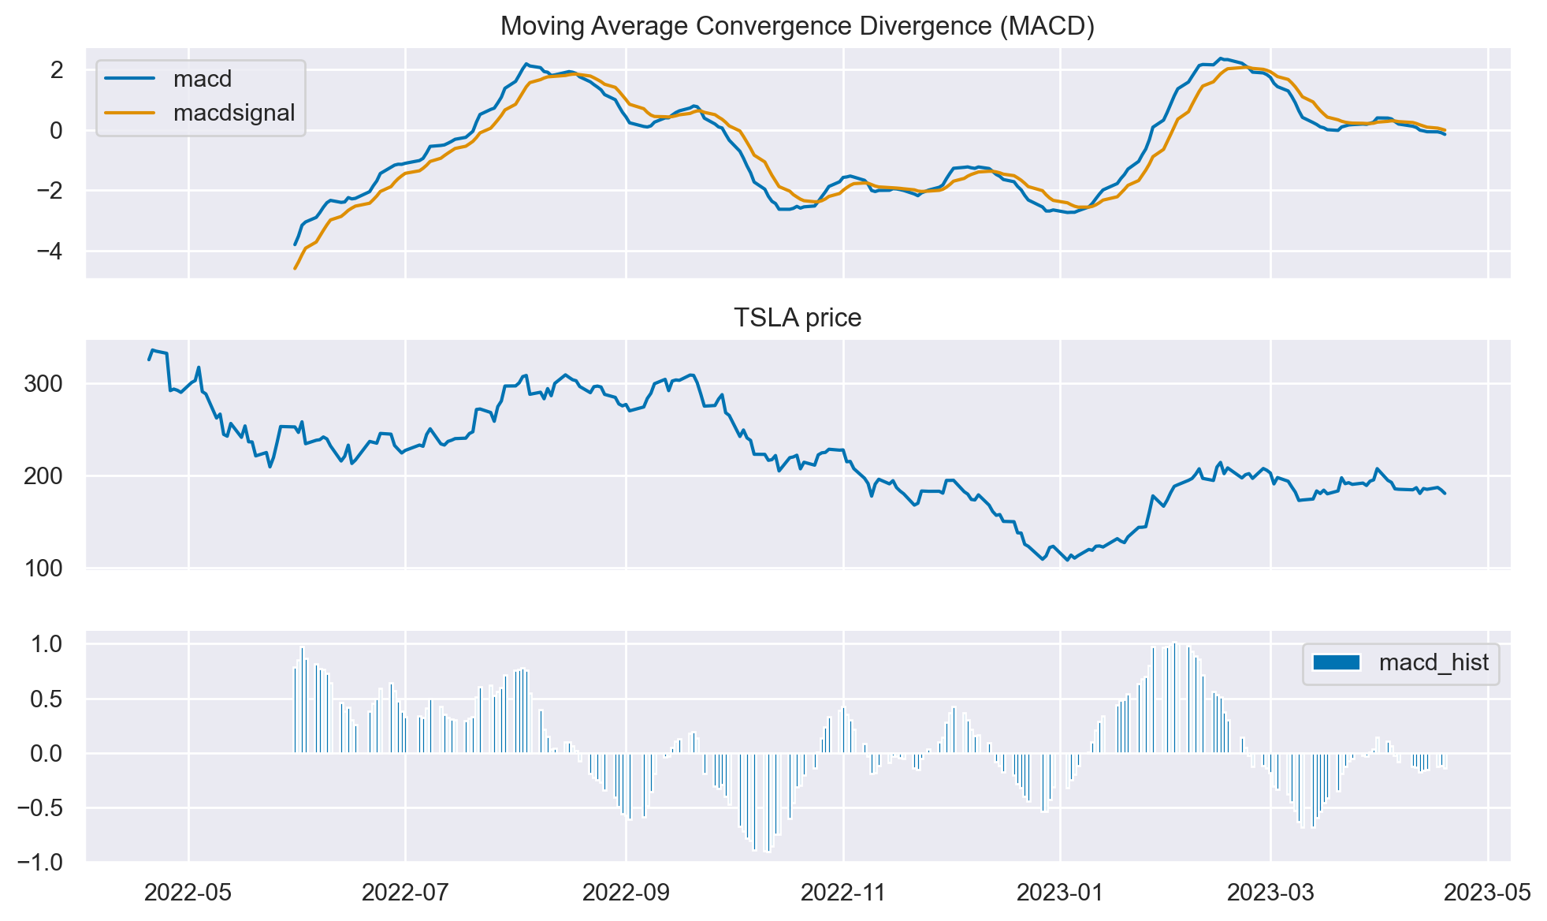
EDA & Visualization

Slide 10
Modeling
Indicator strategies
Moving average convergence divergence
Momentum
Linear Regression
Logistic Regression
Deep Learning

Slide 11
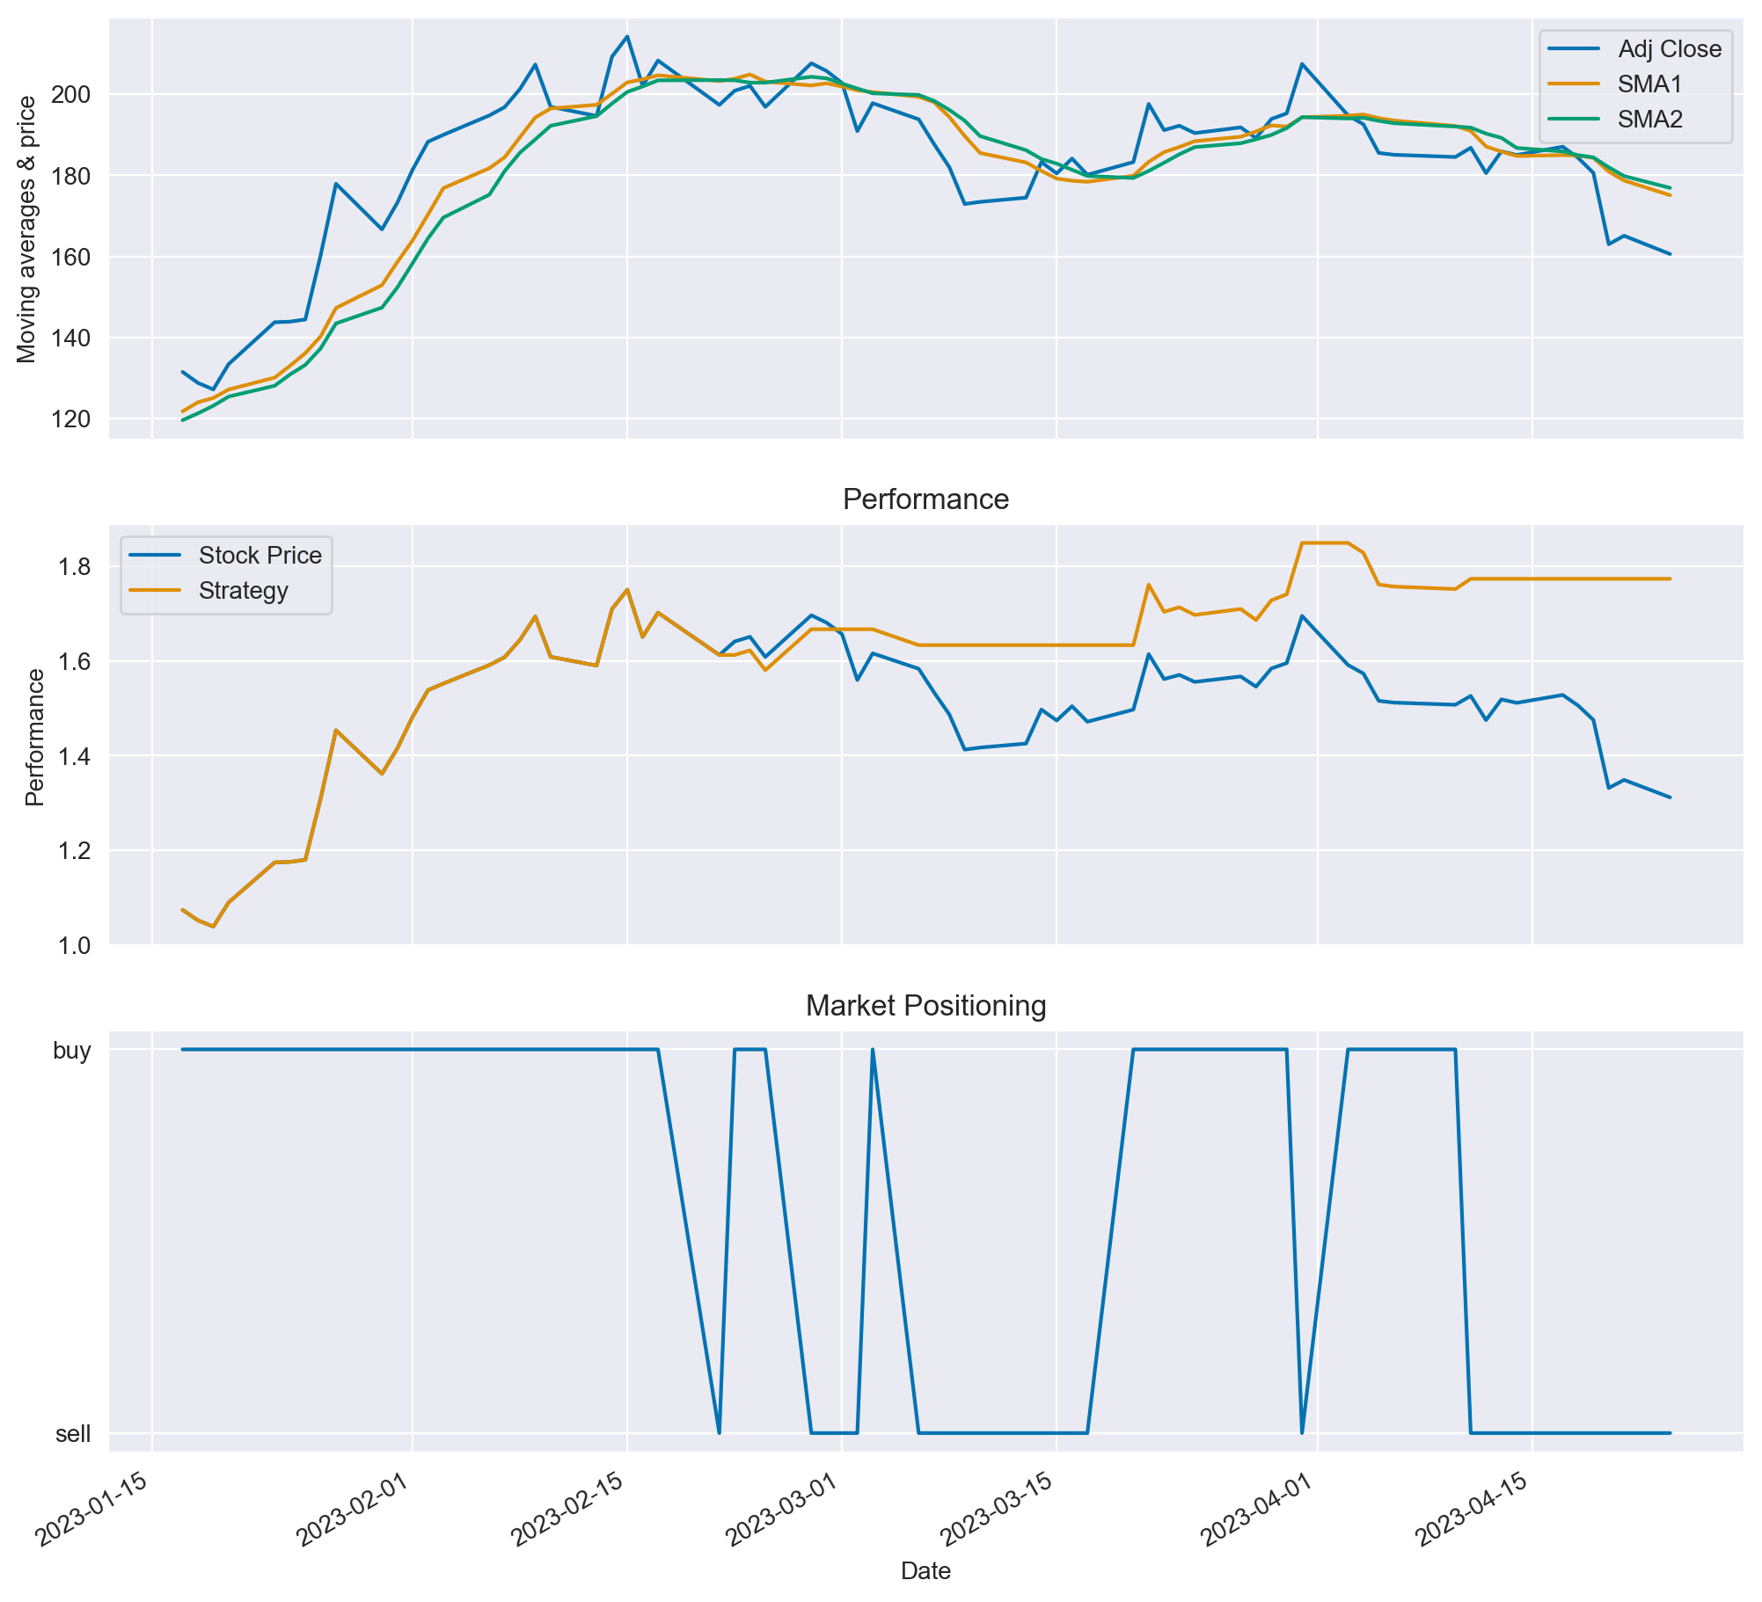
Modeling Indicator Strategies
Moving Average Convergence Divergence
‘Buy’ when SMA1 exceeds SMA2, ‘sell’ when SMA2 exceeds SMA1
SMA1 = 7
SMA2 = 9
Strategy outperformed stock price by 30 percentage pts
Correct on 62% of predictions

Slide 12
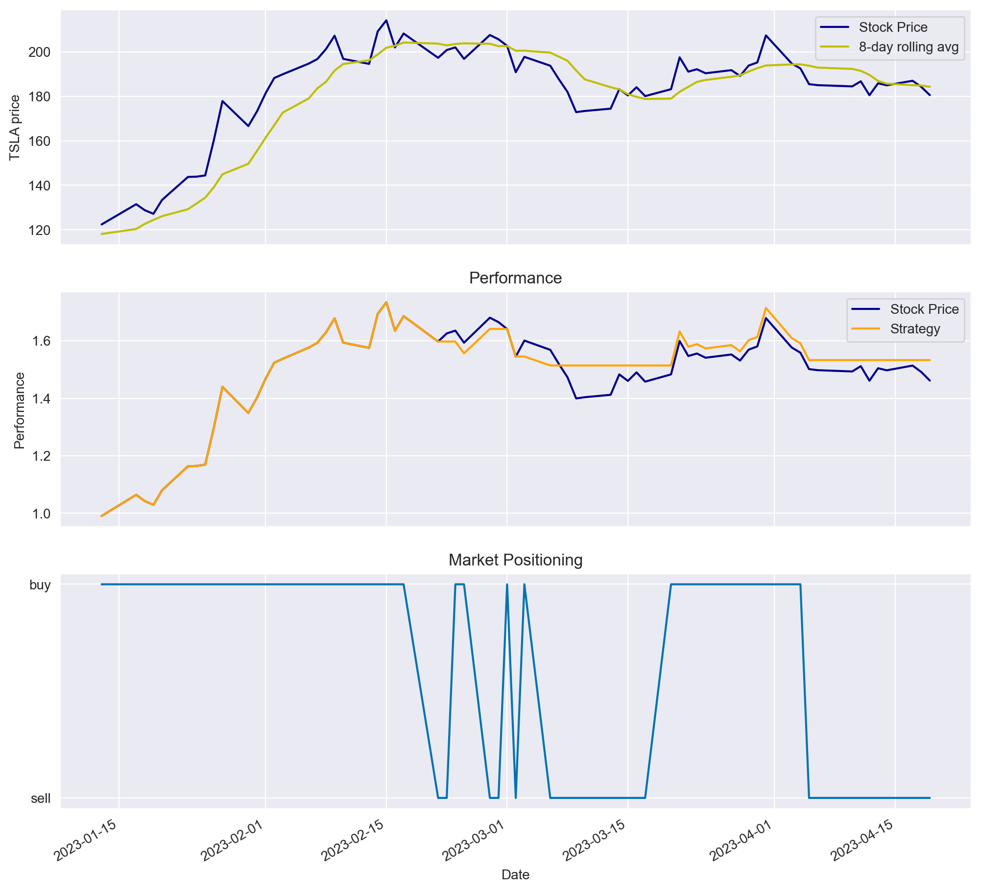
Modeling Indicator Strategies
Momentum
‘Buy’ when rolling average is positive, ‘sell’ when rolling average is negative
Rolling average = 8 days
Strategy outperformed stock price by 7 percentage points
Correct on 58% of predictions

Slide 13
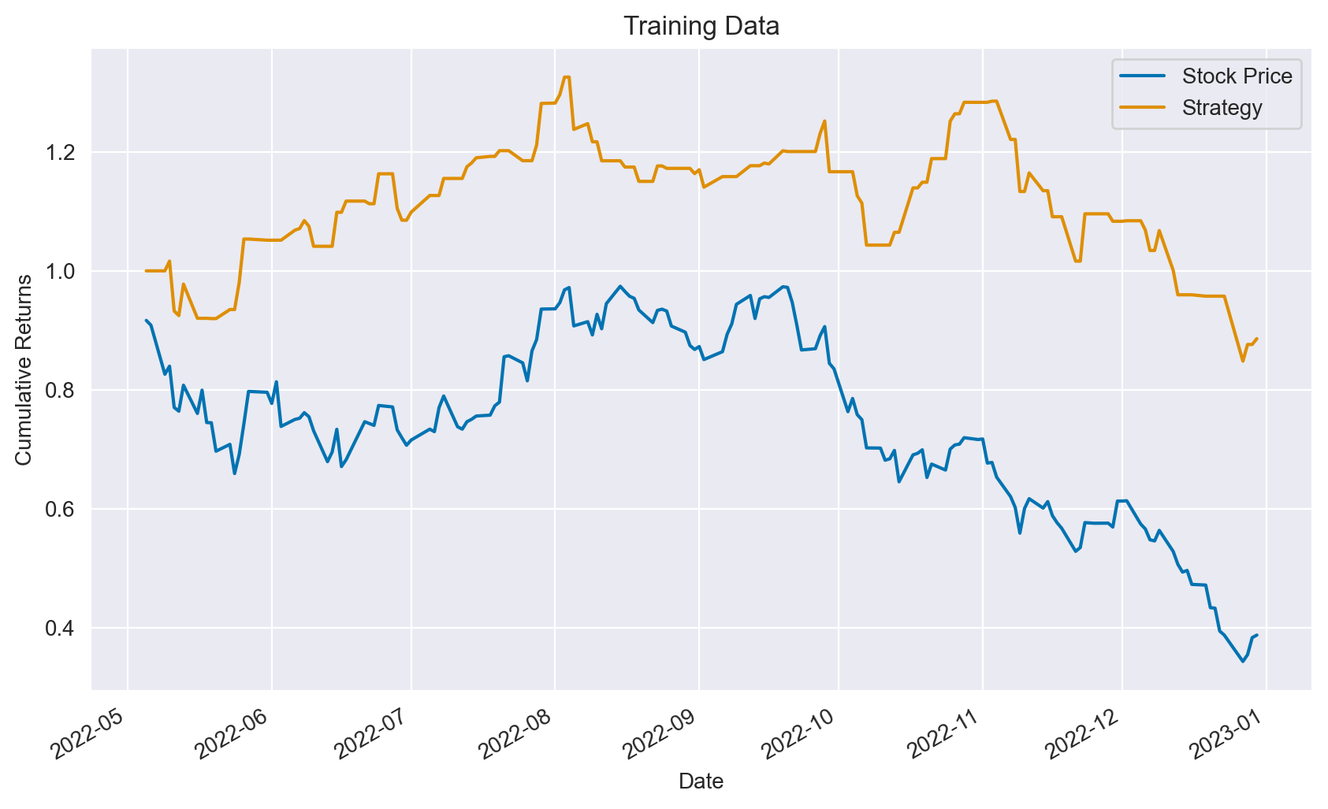
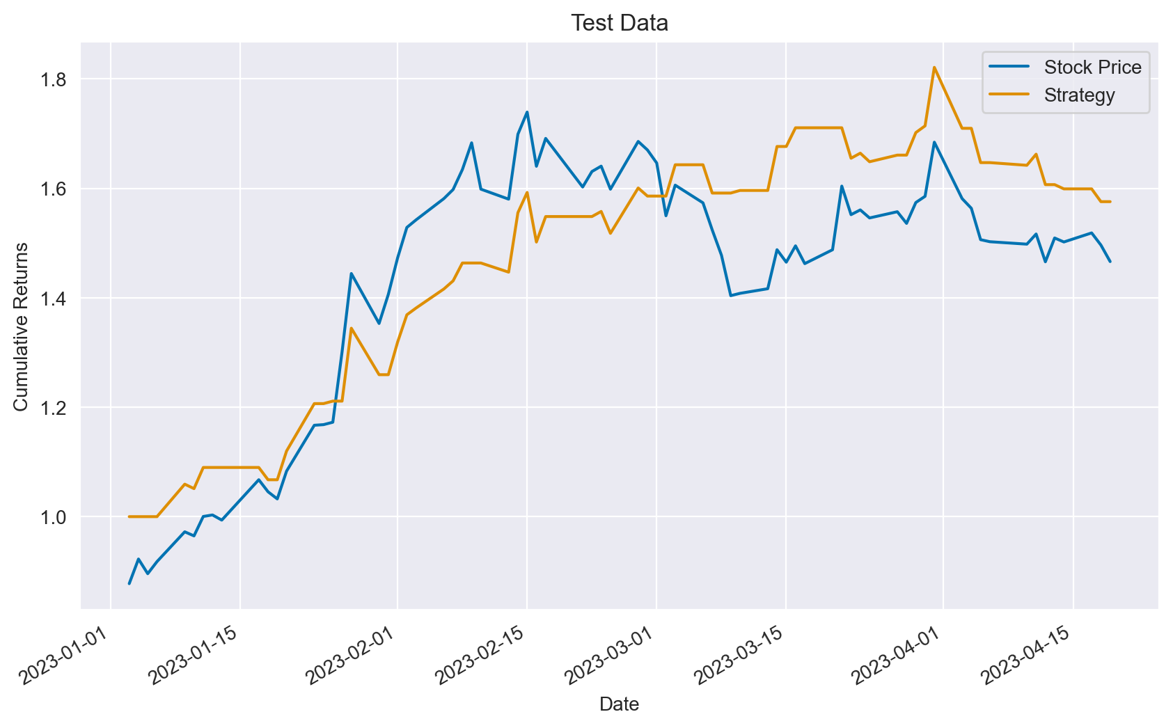
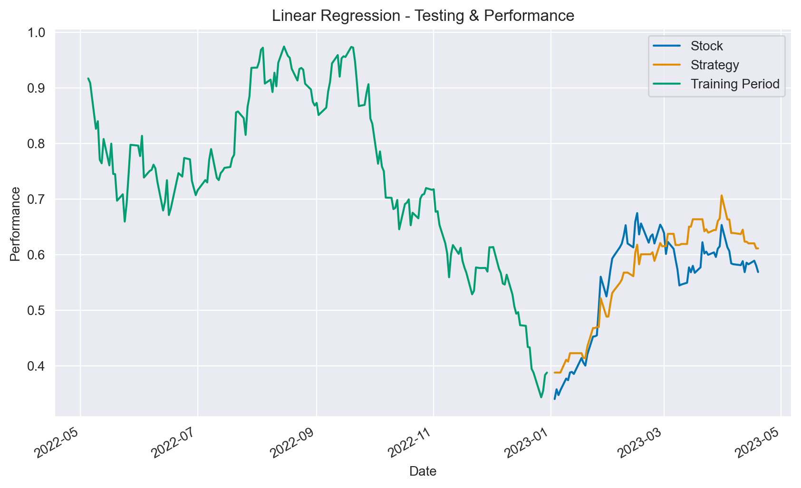
Modeling
Linear Regression
Regression coefficients determined with Numpy’s OLS;
Prediction = np.dot(lags, reg coef)
Strategy (train data) outperformed stock price by 50 percentage pts
Training data – 58% accuracy
Strategy (test data) outperformed stock price by 11 percentage pts
Testing data – 59% accuracy

Slide 14
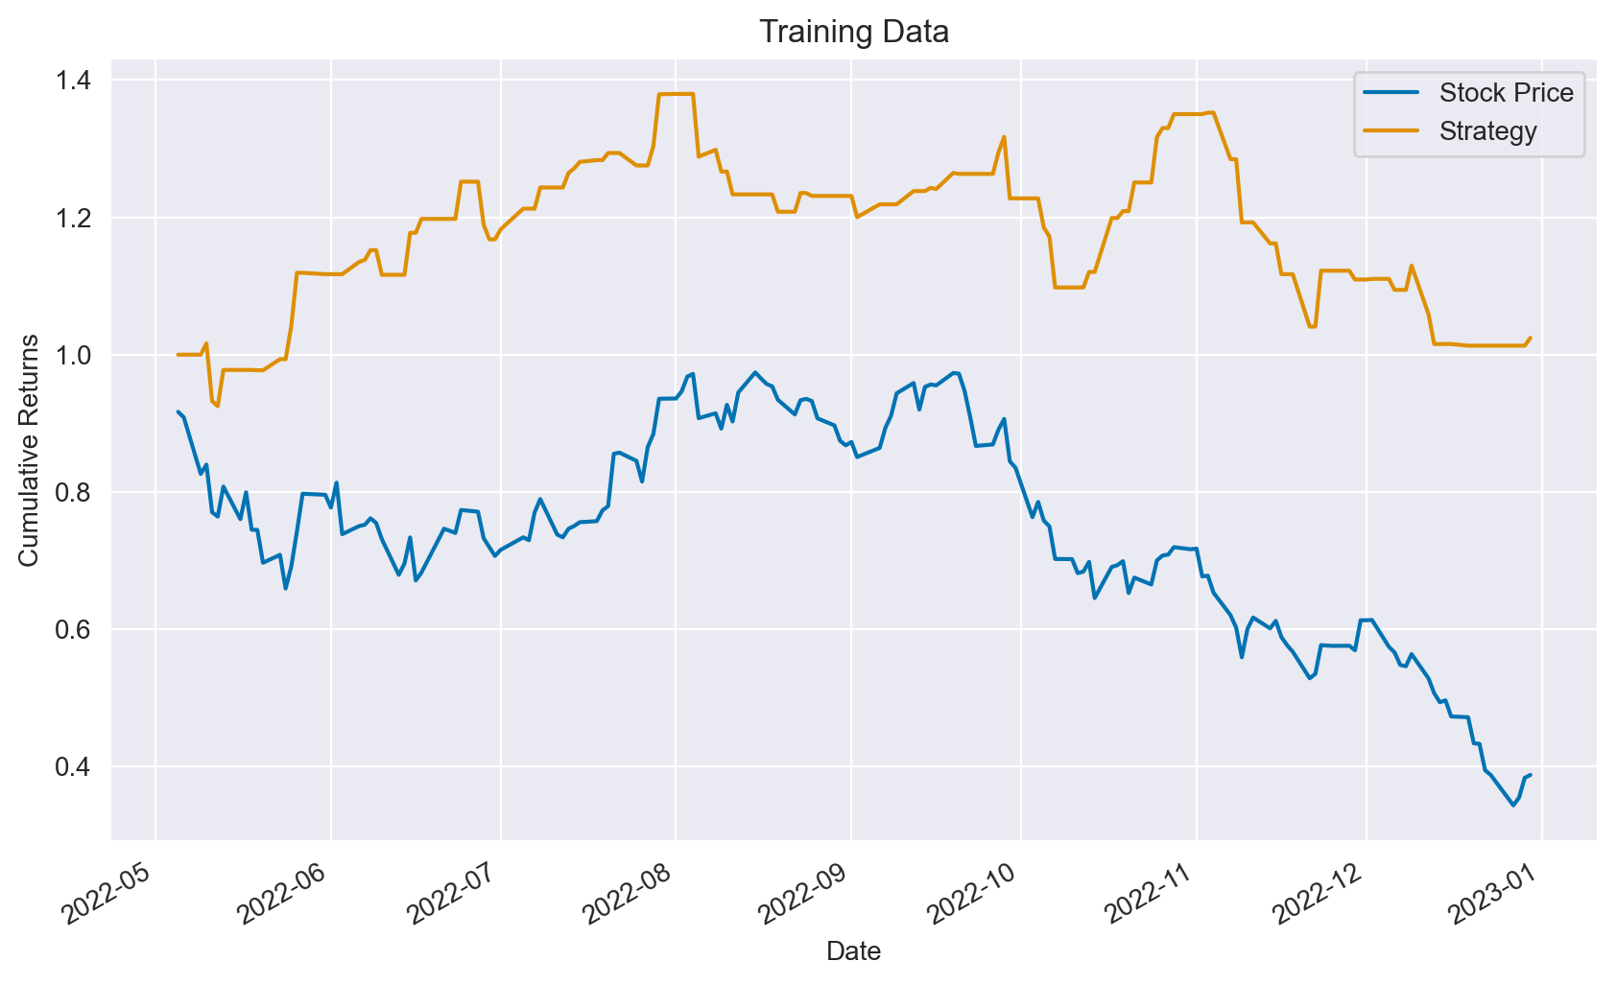
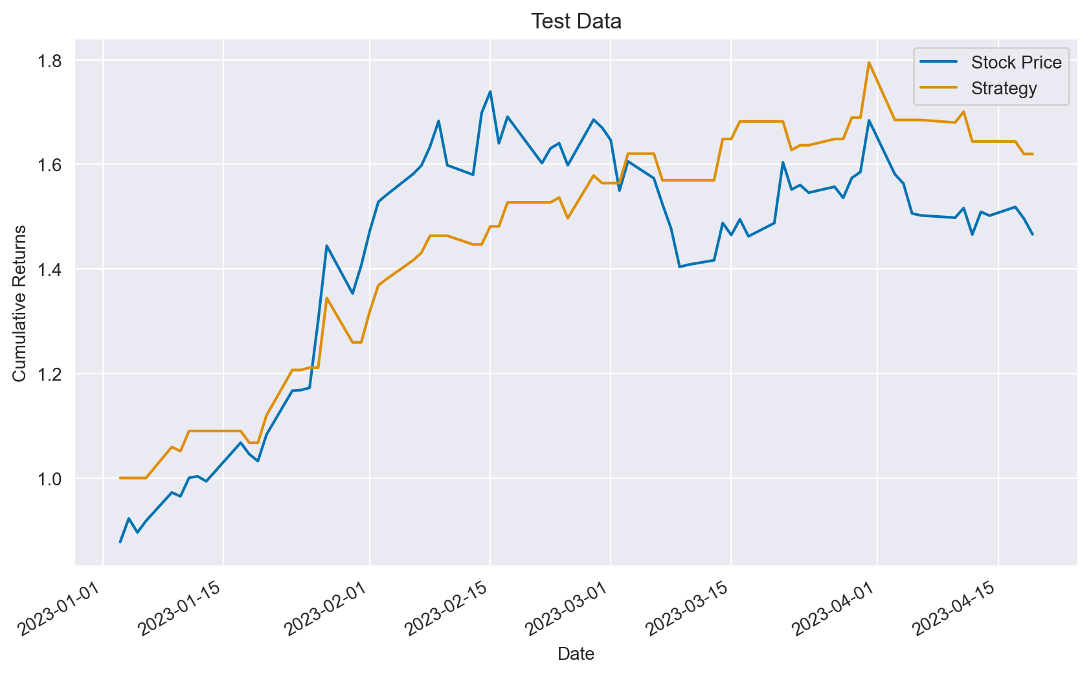

Modeling
Logistic Regression
Sklearn’s LogisticRegression()
Strategy (train data) higher than stock price by 64 percentage pts
Training data – 60% accuracy
Strategy (test data) outperformed stock price by 15 percentage pts
Testing data – 61% accuracy

Slide 15
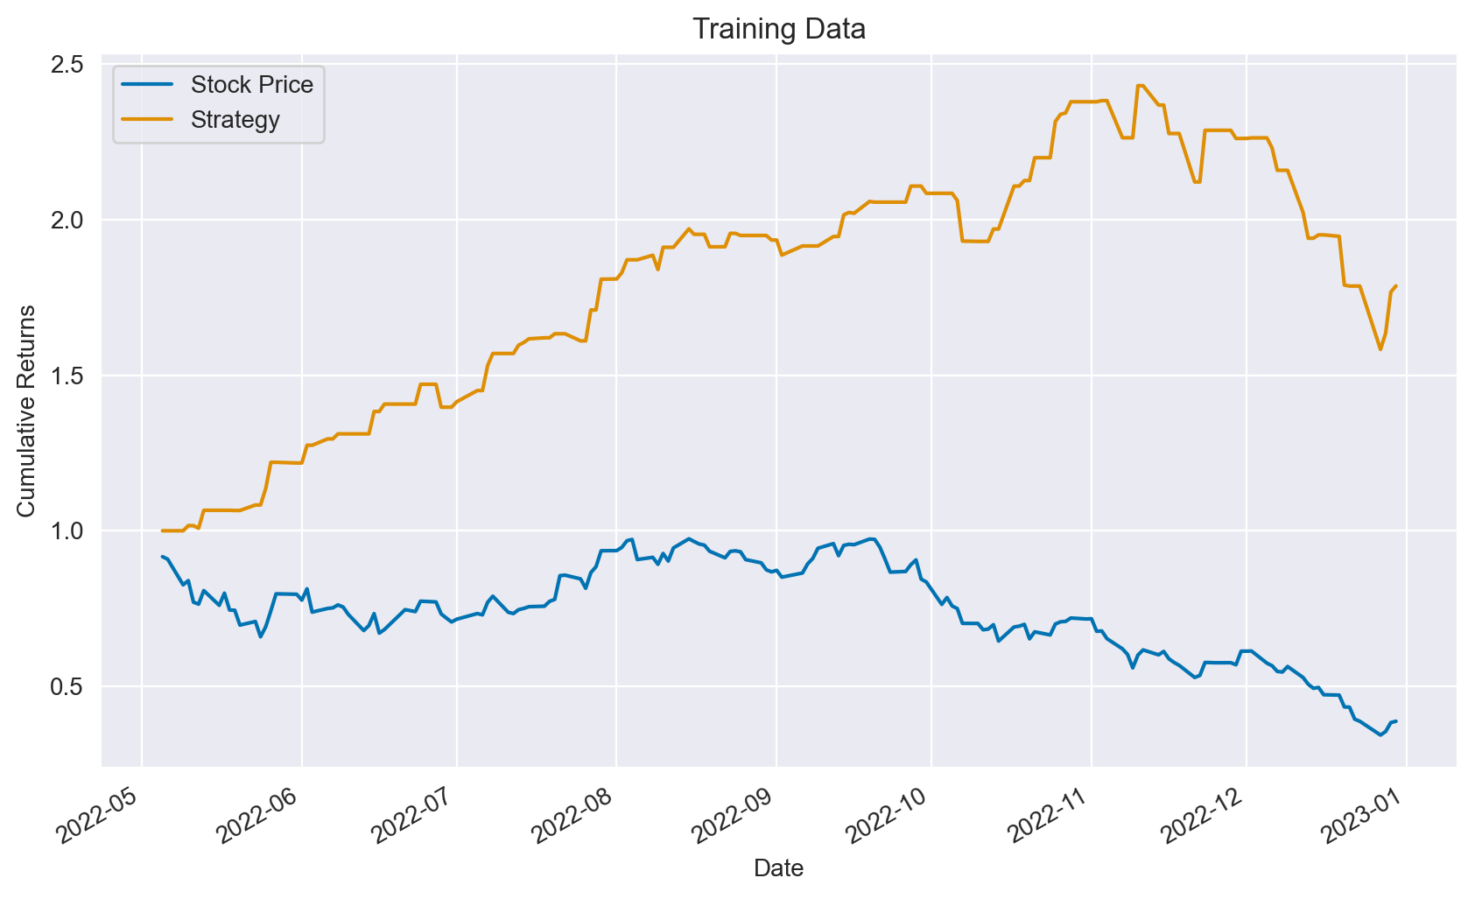
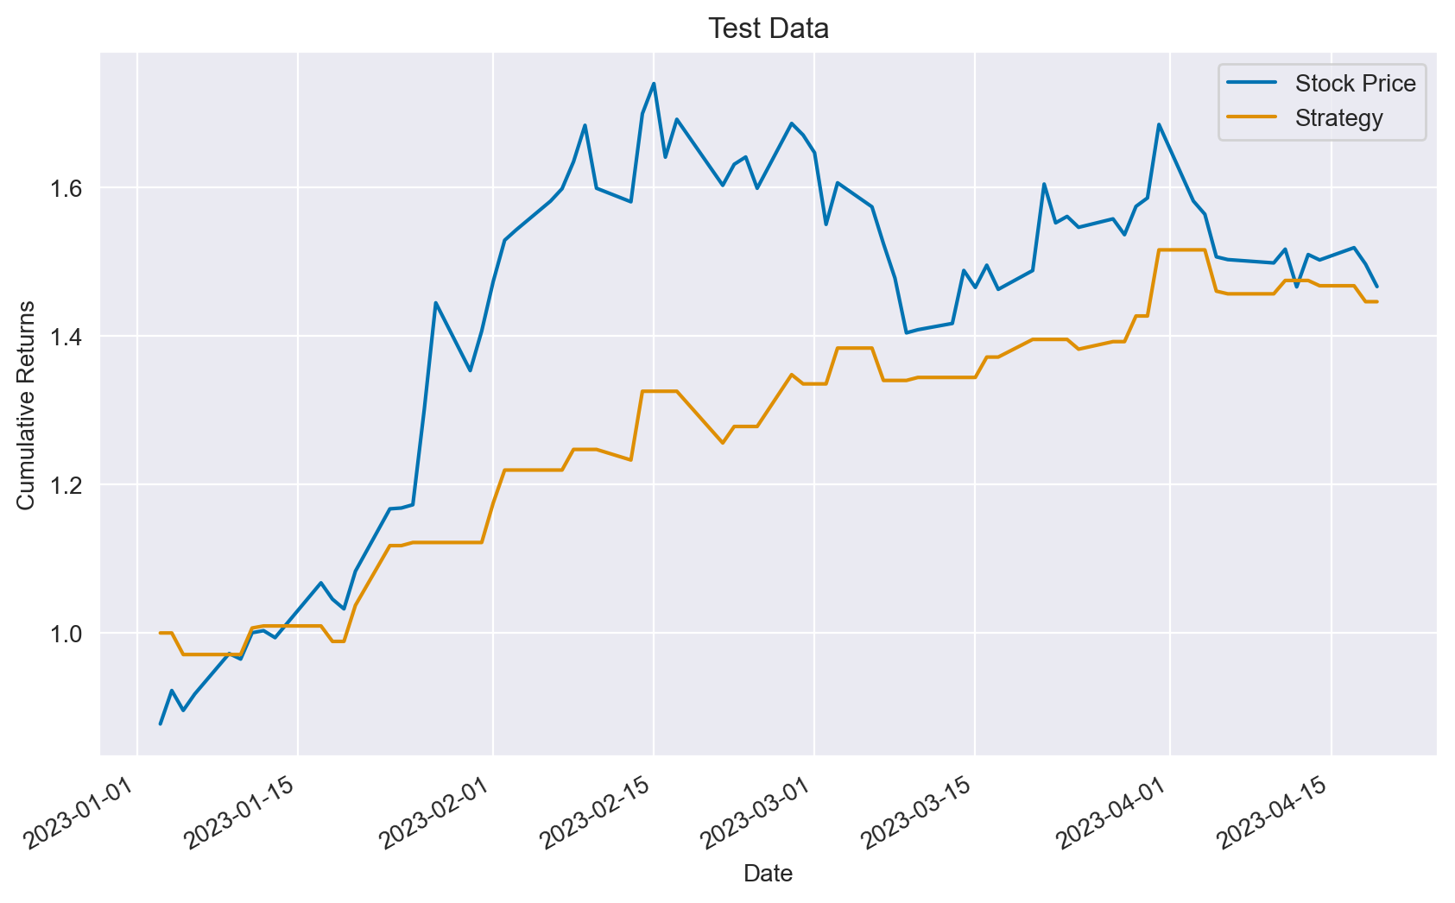
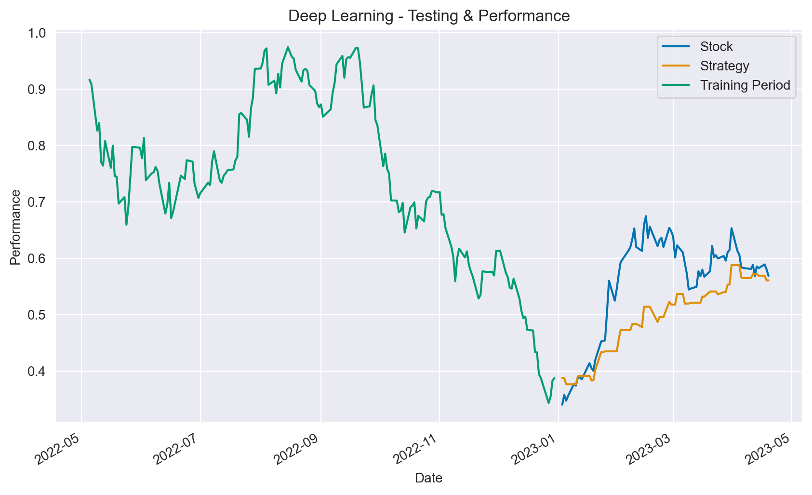
Modeling
Deep Learning
Tensorflow/Keras
Sequential()
Strategy (train data) higher than stock price by 113 percentage pts
Training data – 61% accuracy
Strategy (test data) lower than stock price by 2 percentage pts
Testing data – 55% accuracy

Slide 16
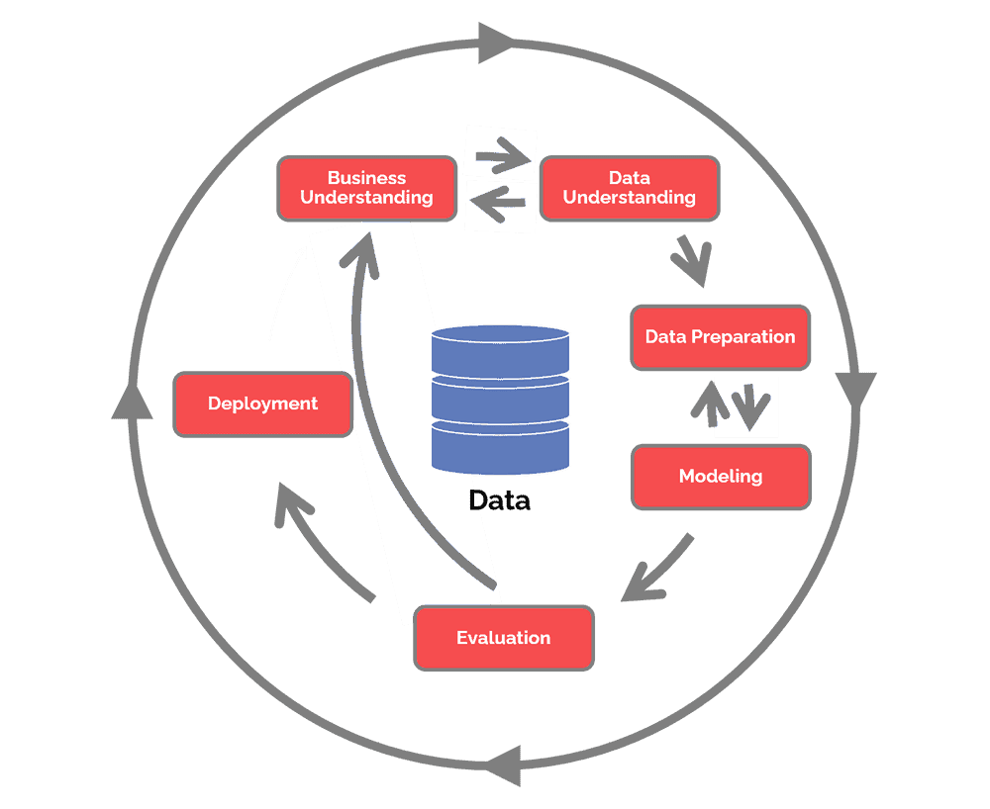

Slide 17
Revised Approach
New features
Lags for all
Ada Boost

Slide 18
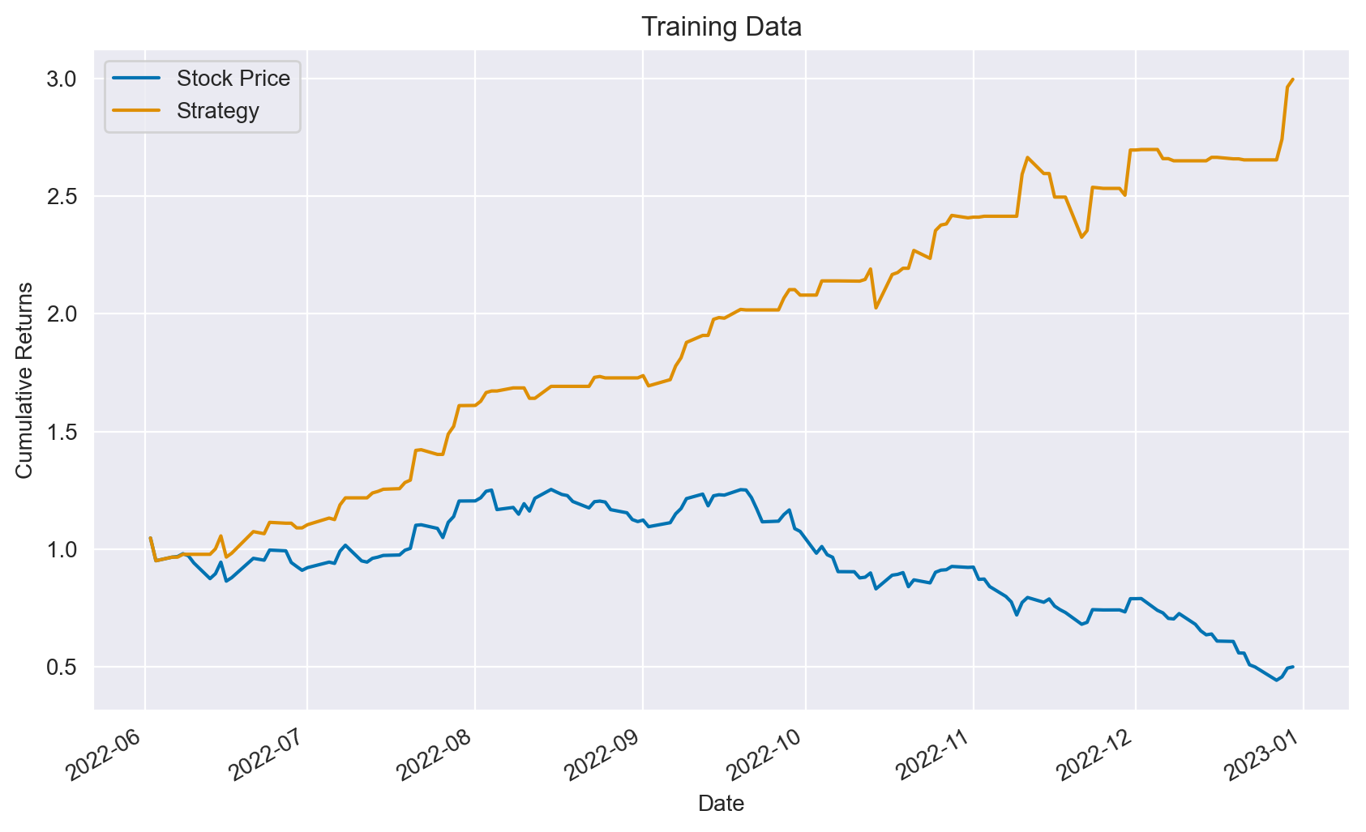
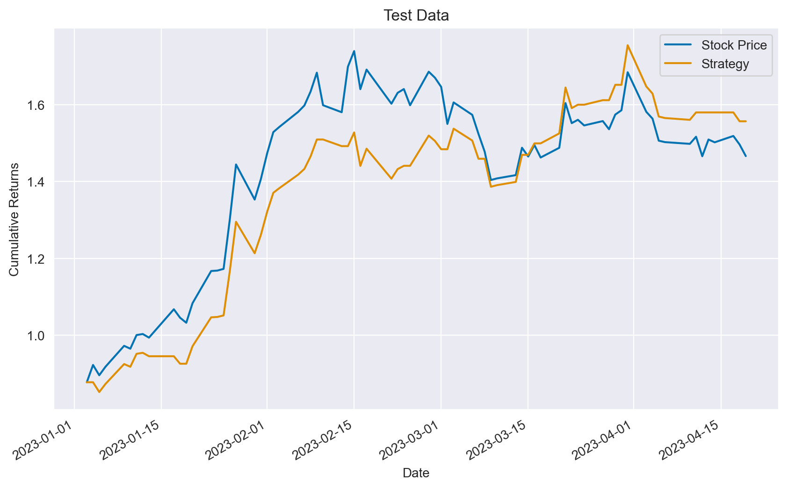
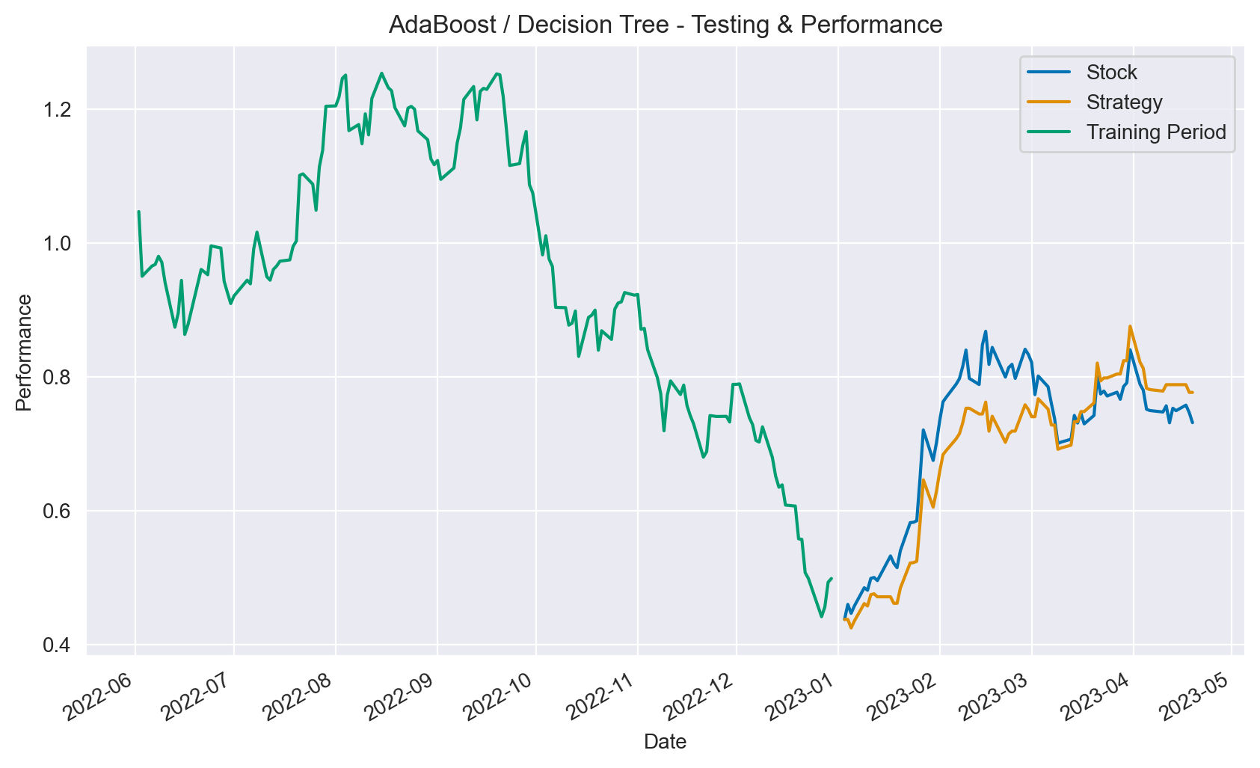
Modeling
Revised Process
AdaBoost() with new features
Strategy (train data) higher than stock price by 250 percentage pts
Training data – 84% accuracy
Strategy (test data) higher than stock price by 9 percentage pts
Testing data – 64% accuracy

Slide 19
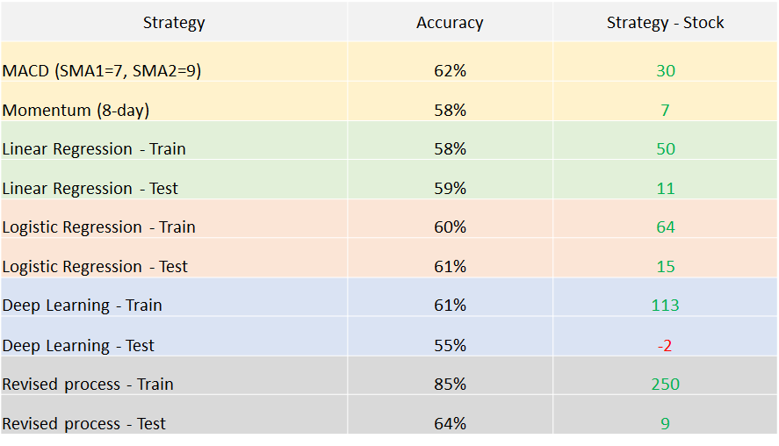
Evaluation

Slide 20
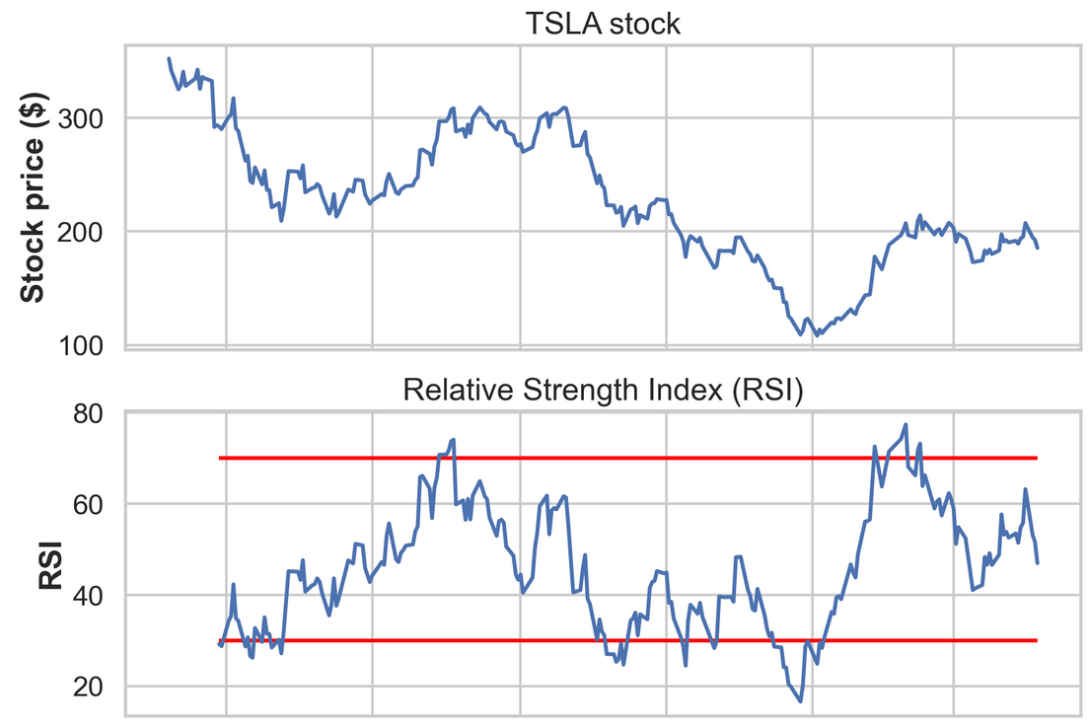
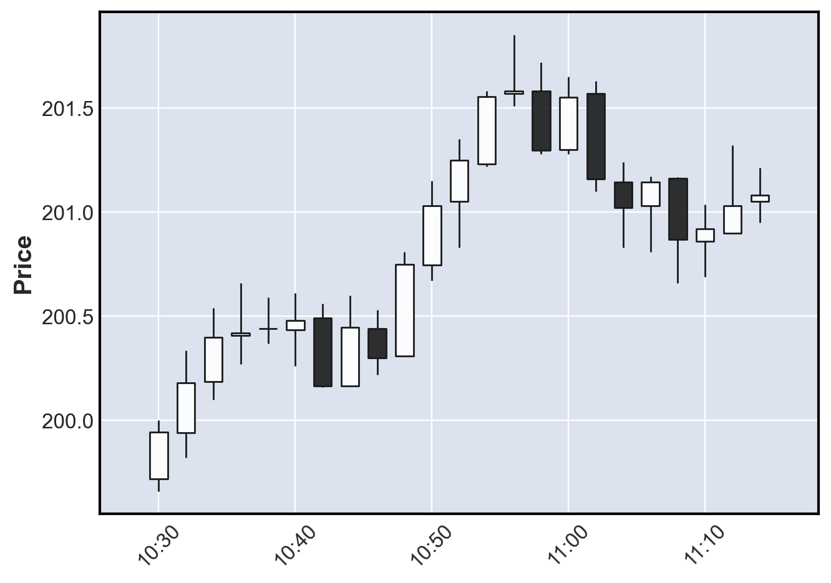
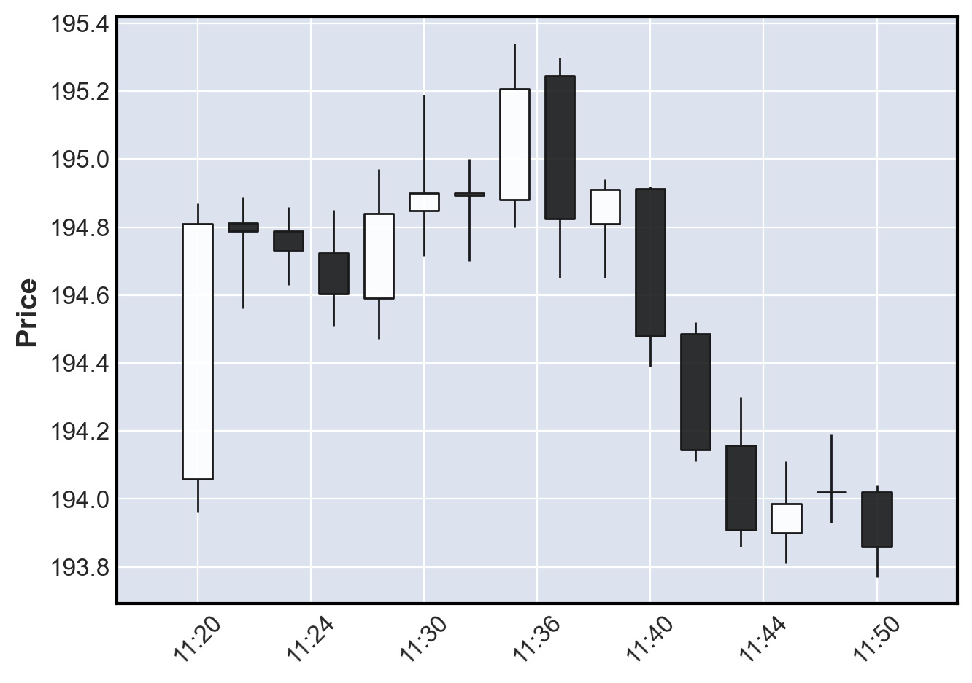
Next steps…
Add other features (RSI, volatility)
Change time intervals
Feature selection
Trend detection (momentum, candlestick)
Text analytics
Deployment

Slide 21
Issues
Ask/Bid discrepancy
Data snooping

Slide 22
Thank you!

